Slide 1
Discipline in the Old Testament
Is God a Killer?
By Jean Sheldon

Slide 2
The Trail Begins . . .
My heritage comes from a personal experience plus intense Bible study, fostered by Graham Maxwell’s picture of God.
The view is that God is just like Jesus, never forceful, angry, and revengeful, but ever loving, kind, and forgiving.
Most inheritors of the view have believed that while God will not kill the wicked at the end, He did kill many people in the flood, Sodom and Gomorrah, and other similar events.
For many years, I shared this view.

Slide 3
My Part of the Journey
Between 2008 and 2011, I drafted a book on the God of the Old Testament, attempting as I have done in class, to soften metaphorically the violent “emergency measures” of the Old Testament.
I used metaphors like “putting people to sleep,” “necessary surgery to save the life of the patient,” and “removing the rotten apple in the barrel to protect the other apples” to try to show that while God used actions that involve force, His motive was to save, not to destroy.

Slide 4
Meanwhile Something Had Happened
In 2011, Jared Wright encountered a man who slugged him in the face, splitting his lip, citing Phineas as justification for “beating him up.”
I was about to write the last chapter in the book where I would explain why, while God could use violent measures and His servants could use them in the OT, we should not.
Wright’s story really challenged me. At one point I considered that the easiest way to deal with Phineas—and God—was to join a minority group in the church, and declare that God never killed.
I sweat through the chapter, maintaining my old position, but with major questions unanswered.

Slide 5
Several Things Bothered Me
If Jesus told us to be mature, like our Father in heaven was mature, because He sent rain and sunshine on the righteous and the unrighteous, how could I justify the violence of God in the OT without giving tacit permission to radical individuals who seek to justify the use of violence now in the name of the OT God?
Ellen White, in DA 759, states that “compelling power is found only under Satan’s government. The Lord’s principles are not of this order. His authority rests upon goodness, mercy, and love, and the presentation of these principles is the means to be used. God’s government is moral, and truth and love are to be the prevailing power.” If this is true, then how could God use compelling power in the Old Testament?

Slide 6
Then Something Else Occurred
Two people very dear to my heart read a book, entitled, As He Is. This book claimed that God has never killed and spent considerable space hypothesizing how events such as the flood, Sodom and Gomorrah, and Korah, Dathan, and Abiram might have taken place.
I wanted to reject the book’s thesis until I reread the following about the fall is Jerusalem in A.D. 70.

Slide 7
“The Jews had forged their own fetters; they had filled for themselves the cup of vengeance. In the utter destruction that befell them as a nation, . . . they were but reaping the harvest which their own hands had sown. . . . Their sufferings are often represented as a punishment visited upon them by the direct decree of God. It is thus that the great deceiver seeks to conceal his own work. By stubborn rejection of divine love and mercy, the Jews had caused the protection of God to be withdrawn from them, and Satan was permitted to rule them according to his will. The horrible cruelties enacted in the destruction of Jerusalem are a demonstration of Satan’s vindictive power over those who yield to his control.

Slide 8
We cannot know how much we owe to Christ, for the peace and protection which we enjoy. It is the restraining power of God that prevents mankind from passing fully under the control of Satan. . . . But when men pass the limits of divine forbearance, that restraint is removed. God does not stand toward the sinner as an executioner of the sentence against transgression; but He leaves the rejectors of His mercy to themselves to reap that which they have sown. Every ray of light rejected, every warning despised or unheeded, every passion indulged, every transgression of the law of God is a seed sown which yields an unfailing harvest. The Spirit of God, persistently resisted, is at last withdrawn from the sinner, and then there is left no power to control the evil enmity of Satan. The destruction of Jerusalem is a fearful and solemn warning to all who are trifling with the offers of divine grace and resisting the pleadings of divine mercy.” GC 35, 36

Slide 9
I had always applied these words strictly to the final plagues and the final destruction of the wicked.
As I read it this time, I realized that she was making an overarching statement, applying it across the board to all God’s acts of punishment or judgment, words she uses in connection with the destruction of Jerusalem.
In other places she uses the same words—punishment and judgment—to describe acts of God in the Old Testament such as the flood (GC 339, PP 101, 160).
This explains why, when she felt it appropriate, such as in the incident of the snakes in Numbers, she explained that this was not an act of God, but rather He stopped protecting them (PP 429).

Slide 10
Hermeneutical Issues
Typically we have taken passages that speak of God directly destroying the wicked at the end, and by using other passages, show that the destruction is not a direct act of God. Yet we deny this hermeneutic, which works just as well, regarding stories where God is said to destroy people.
If we could believe that God did not directly harden Pharaoh’s heart (Ellen White) and that the fires of hell do not really burn forever and ever, again, by using other texts (historic Adventism), why do we insist that God actually did send the flood and burn up Sodom and Gomorrah simply because it says He did? Is this a consistent hermeneutic?

Slide 11
Did God Do These Things?
“The Lord will send on you disaster, panic, frustration in everything you attempt to do.”
“The Lord will cause pestilence cling to you until it consumes you from the land.”
“The Lord will afflict you with consumption, fever, inflammation, with blazing heat and drought, and with blight and mildew.”
“The Lord will make you defeated before your enemies.”
“The Lord will afflict you with the boils of Egypt, with ulcers, scurvy, and itch.” Deut. 28

Slide 12
God hardens Pharaoh’s heart (Ex. 7:3; 9:12; 10:1, 20, 27; 11:10).
God puts a leprous disease in a house (Lev. 14:34).
God sends an evil spirit between Abimelech and the lords of Shechem (Jdg. 9:23).
Samson’s desire to marry a woman from Timnah is from the Lord because He was seeking a pretext to go against the Philistines (Jdg. 14:4).
The Lord brought Naomi back empty and dealt harshly with her (Ruth 1:21).
Eli’s sons refuse to listen to their father because the Lord wanted to kill them (1 Sam. 22:25).

Slide 13
An evil spirit from the Lord tormentes Saul (1 Sam. 16:14).
David states that the Lord told Shimei to curse him (2 Sam. 16:10, 11).
The Lord raises up an adversary (a satan) against Solomon (1 Kgs. 11:14, 23).
Elijah charges God with killing the widow of Zarephath’s son (1 Kgs. 17:20).
The Lord puts a lying spirit into the mouth of the false prophets (1 Kgs. 22:19-:23).
God says he will bring a nation from far away against Jerusalem (Jer. 5:15-17).

Slide 14
The Bible Says It Two Ways
Did God or Satan tempt David to number Israel (2 Sam. 24:1; 1 Chron. 21:1)?
Solomon commands Benaiah to kill Joab in the temple courts because the Lord will bring back on his own head the innocent blood he shed (1 Kgs 2:28-33), yet Solomon does this himself because he believes that the role of the king was to administer divine justice.
Did God give commands to Israel to offer their firstborn so that they might horrify them (Ezek. 20:25, 26) or did that thought never enter His mind and He never commanded it (Jer. 7:31)?
Did Saul kill himself or did the Lord (1 Chr. 10:4-14)?

Slide 15
Two Ways in Similar Contexts
God sends a prophet to Jeroboam with a message but warns him not to stop for anything on the way home. He disobeys and is killed by a lion. The older “prophet” who had lied to him said, “the Lord has given him to the lion” (1 Kgs. 13:26).
“The Lord will strike Israel, as a reed is shaken in the water; he will root up Israel out of this good land that he gave to their ancestors, and scatter them beyond the Euphrates…. He will give Israel up because of the sins of Jeroboam…” (1 Kgs. 14:15, 16, NRSV).

Slide 16
Look at the Writers
“The Bible is written by inspired men, but it is not God’s mode of thought and expression. It is that of humanity. God, as a writer, is not represented. Men will often say such a expression is not like God. But God has not put Himself in words, in logic, in rhetoric, on trial in the Bible. The writers of the Bible were God’s penmen, not His pen. Look at the different writers” (1 SM 21).

Slide 17
A Consistent Hermeneutic
Previously, I have suggested that the Old Testament speaks in two voices—
a major voice that adapts the divine will to the choices and understanding of the people, and
a minor voice that speaks more closely to God’s ideal or preferred will.
Rhetoric that declares that God does this or that act is clearly speaking in the major voice because such wording reflects human perceptions, perceptions that prevailed in the ancient Near East.

Slide 18
Evidence
Angry gods are said to level the land in the same breath that enemy forces are said to level cities, tells, and temples. Text 20 in Westenholz, Legends of the Kings of Akkade, 276-277.
“Father Enlil, by means of his angry commands, has overthrown the homeland.” Michalowski, The Correspondence of the Kings of Ur, 207.
“The arrogant, the agreement-violator, he [Enlil] does not tolerate their evil in the city. . . . He does not let the wicked and evildoer escape its [the net’s] meshes….” Kramer, The Sumerians, 120-121.
“O my lord, my wrongdoings are many, great are my sins. God in the rage of his heart has confronted me; the Goddess has become angry with me and made me ill.” Babylonian psalm cited in Magdalene, On the Scales of Righteousness, 15.

Slide 19
Ludlul bel nemeqi I Will Praise the Lord of Wisdom
Tablet I
1 Let me praise the lord of wisdom, a god judicious,
2 Angry at nighttime, loosening up in daytime.
3 Marduk, lord of wisdom, a god judicious;
4 Angry at nighttime, loosening up in daytime;
5 Who is like a storm, a violent storm; his fury is desolate;
6 And, like the breeze of the morning, his blowing is good.
7 His fury is unfaceable; the deluge is his boiling fury.
8 His mind is merciful; his heart is relenting—
9 The main force of whose hand the heavens cannot bear,
10 Whose hand of greatness helps the dead.
11 Marduk, whose powerful hands the heavens cannot bear;
12 The greatness of whose hand helps the dead.

Slide 20
13 In his wrath, he opens graves
14 When in slaughter, he causes the fallen to rise.
15 He looks angrily; the lamassu and shades depart.
16 He sets his eye and the personal god turns back to the one he pushed away.
17 For an instant, his heavy punishment is terrible.
18 But suddenly he has pity; he turns into his mother.
19 He hastens to treat his beloved kindly.
20 Like a cow (with its) calf, my cow rotates (with me).
21 His beatings are thorns/barbs; he pierces the body.
22 Soothing are his bandages; he heals the victims of Namtar/the dying.
23 When he speaks, he imposes crimes on one.
24 In the day of his judgment, debts and sins are absolved.
25 It is he who oppresses; he makes people sick.
26 By his incantation, shivers and chills are expelled.

Slide 21
In a Nutshell…
The hermeneutic I am employing is one Adventists have used since the beginning of the movement.
It does not cancel out texts, but reinterprets those texts in light of three things:
Clearer texts that explain the difficult texts
The character of God revealed more fully (e.g., the life of Christ)
Simple common sense or logic

Slide 22
The Big Question Is…
Why should we believe that God did not harden Pharaoh’s heart, that the wicked will not burn forever, that God did not send a lying spirit to influence the false prophets, that He did not slay Saul, that He is not responsible for natural disasters, that He will not send the final plagues, and that He will not destroy the wicked at the end (even though the Bible says He did and will), but at the same time insist that He directly sent the flood, burned up Sodom and Gomorrah, swallowed up Korah, Dathan, and Abiram, consumed Nadab and Abihu, struck Uzzah, and slew 85,000 Assyrians (because the Bible says He did)?

Slide 23
Asked Another Way…
How does God destroy?
Does He ever need to destroy, or are there forces available at any time to do their destructive work, if God simply lets them?
Of course, some have argued that Satan would hardly be willing “to do God’s dirty work.”
Yet, does Satan love his own that much?
And besides Satan, aren’t there plenty of other dangerous things around to destroy us if God didn’t protect us?

Slide 24
Yet Another Question
Most Adventists are convinced that God is not directly responsible for the natural disasters in our world.
Many evangelists have, to attract members, argued that either Satan or we humans are responsible.
Why would God not be directly responsible for flooding like Katrina, but responsible for the first flood?
Has God changed in the 20th to 21st centuries in the way He deals with human beings from how He dealt with them in the Old Testament?

Slide 25
Reading Ellen White…
She speaks of God’s judgments at work in land and sea. “The judgments of God are in the land. He is sending them upon men by land and by sea” (ST April 25, 1900).
Yet she also said, “I was shown that the judgments of God would not directly out from the Lord upon them, but in this way: They place themselves beyond His protection. He warns, corrects, reproves, and points out the only path of safety; then, if those who have been the objects of His special care will follow their own course independent of the Spirit of God, after repeated warnings, if they choose their own way, then He does not commission His angels to prevent Satan’s decided attacks upon them. It is Satan’s power that is at work at sea and on land, bringing calamity and distress and sweeping off multitudes to make sure of his prey” (14 MR 3 [1883]; LDE 242).

Slide 26
Canonically Reading the OT
In previous presentations, I have argued that the minor voice of God’s preferred will comes first in a narrative sequence or first canonically speaking.
What is the first instance of God killing people in the Old Testament? And how is it stated?
Before we move to this, note that when Cain murders his brother Abel, God does not call for his death, but actually protects his life! What does this say for God’s regard for human life?

Slide 27
How the Flood Is Stated
“My spirit shall not abide in mortals forever, for they are flesh” (Gen. 6:3).
“So the Lord said, ‘I will blot out from the earth the human beings I have created” (6:7).
“I have determined to make an end of all flesh, for the earth is filled with violence because of them; now I am going to destroy them along with the earth” (6:13). sic! Let’s try again!
“An end of all flesh has come before me; . . . and behold me ruining/destroying them with the earth.”

Slide 28
Explanation
The major voice in these texts is fairly strong, but by removing the translator’s bias and letting the Hebrew wording remain, the minor voice can be heard.
The violence of humankind is destroying the earth and those who insist on violence will be destroyed with it.
No wonder God grieves that He regrets ever creating humankind only to have them destroy themselves.

Slide 29
After the Flood . . .
God gives the first statement regarding taking human life in Genesis 9:5, 6, NRSV:
“For you own lifeblood I will surely require a reckoning: from every animal I will require it and from human beings each one for the blood of another, I will require a reckoning for human life. Whoever sheds the blood of a human, by a uman shall that person’s blood be shed; for in his own image God made humankind.”
Note: the word “require” means “to investigate, seek out, or care for” something or someone.

Slide 30
Canonically, this text precedes the sixth commandment that forbids murder. Scholars are quick to point out that the word “kill” in Exodus 20:13 refers to murder, since it is used only of humans, not of animals. They suggest that it does not forbid killing in war, capital punishment, or killing in self-defense.
In Genesis 9:5, 6, however, God is against all bloodshed. If one understands that God is said to do what He allows in the OT, then the text really states that He will undertake the case of any person killed by another and the killer will be killed by yet another (natural effect)—because God made humans in His own image (and murder is the destruction of that image). This clearly rejects all human killing because of the term “shed the blood.”
If all human bloodshed is wrong for humans, is it not wrong for God?

Slide 31
Sodom and Gomorrah
This story is an interesting example of minor and major voices in a single narrative.
The narrative begins with God telling Abraham about conditions in Sodom.
“Then the Lord said, ‘How great is the outcry against Sodom and Gomorrah and how very grave their sin! I must go down and see whether they have done altogether according to the outcry that has come to me; and if not, I will know’” (Gen. 18:20, 21, NRSV).
So far God says nothing about destroying Sodom.

Slide 32
“Then Abraham came near and said, ‘Will you indeed sweep away the righteous with the wicked? . . . Far be it from you to do such a thing, to slay t righteous with the wicked, so that the righteous fare as the wicked!’” (vv. 23, 25) In keeping with ancient Near Eastern views, Abraham assumes God is planning to destroy the people of Sodom.
“And the Lord said, ‘If I find at Sodom fifty righteous in the city, I will forgive the whole place for their sake.’ Abraham answered, ‘. . . Will you destroy the whole city for lack of five?’ And he said, ‘I will not destroy it if I find forty-five there.’” (v. 28)
God only states “I will not destroy it” after Abraham uses it in application to God.

Slide 33
In the next chapter, the angels declare, “For we are about to destroy this place, because the outcry against its people has become great before the Lord, and the Lord has sent us to destroy it” (19:13).
The initial statements by God are the “reckoning” statements of investigation. These come first in the Sodom narrative and thus form the minor voice of God’s preferred will.
After Abraham assumes God plans to destroy Sodom, the major voice that follows that assumption states that the Lord has sent the angels to destroy Sodom.
And how do they destroy the city? By leading Lot and family from it so that God can let it go?

Slide 34
Canonical Bookends
Two final canonical stories of God killing someone occur in the book of Acts.
When confronted with his lying to the Holy Spirit, Ananias drops dead in front of the believers.
When Sapphira comes in, Peter confronts her and predicts her demise upon which she dies. But nothing is said in the entire story about God doing the killing.
In Acts 12, Herod accepts worship from the people, and “an angel of the Lord struck him down, and he was eaten by worms and died” (v. 23, NRSV).
Did the angel have to strike him or merely leave him?

Slide 35
Conclusion
Given the evidence above and the hermeneutic that Seventh-day Adventists have used from their inception, I have come to believe that God has never taken life directly, that is, killed anyone. The way the stories are worded reflects human rhetoric (and all that is human is imperfect), a rhetoric that imperfectly attributes directly to God what He allows or brings about by withdrawing His protection. Or to put it another way, when people cut themselves off from that protection God can no longer effectually restrain the consequences.

Slide 36
Application
Understanding the difficult stories of God’s discipline in the OT as I now do has caused a significant change in my life.
In my past, I have used methods on students, people in general, and pets that were occasionally insistent, if not forceful. I once terrified my cat so that she wouldn’t claw my furniture (she gave it a wide berth for weeks).
I justified my actions because of believing that God used such measures in the Old Testament.

Slide 37
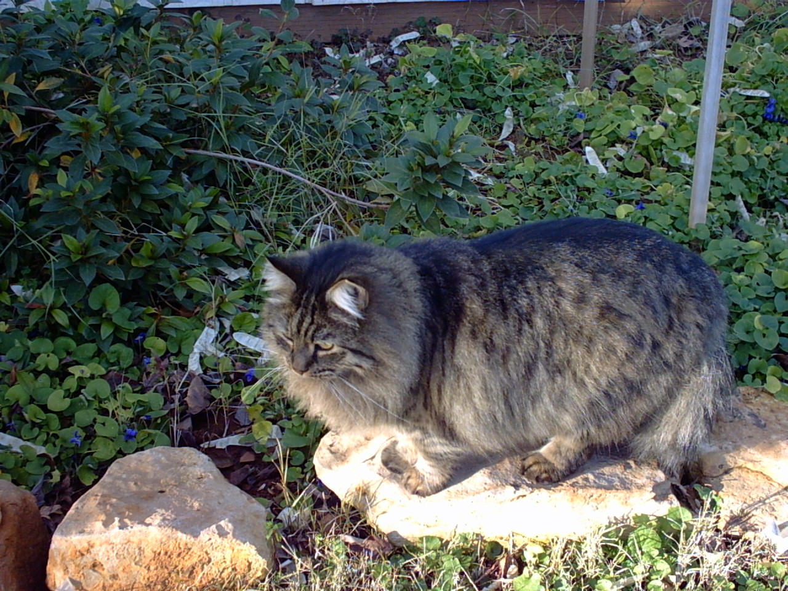
I am now trying to reform!

